Slide 1

A LANGUAGE FOR SPATIAL LOGIC
Swatch
Logic you can live in.
Kate Galvin
CMSI Senior

Slide 2

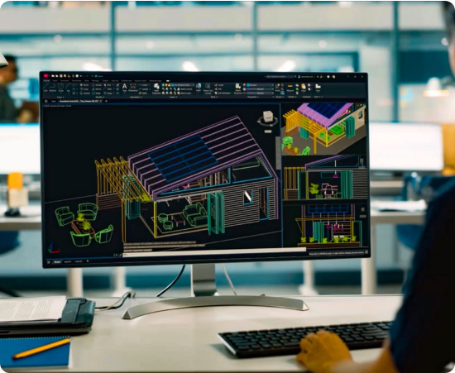
The Complexity Trap
Overly Complicated Processes
Professional design software is built for precision, not intuition. It's heavy, overwhelming, and oftentimes expensive.
Swatch was born from a desire for a way to describe a space in a simple programmatic way.

Slide 3
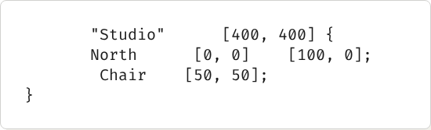
Logic as a Blueprint
Declarative Drafting.
Layout
size
In Swatch, you don't "draw" pixels. You declare intentions.
Wall
from
to
place
at
The compiler handles the coordinate math, the grid lines, and the high-contrast rendering automatically.

Slide 4
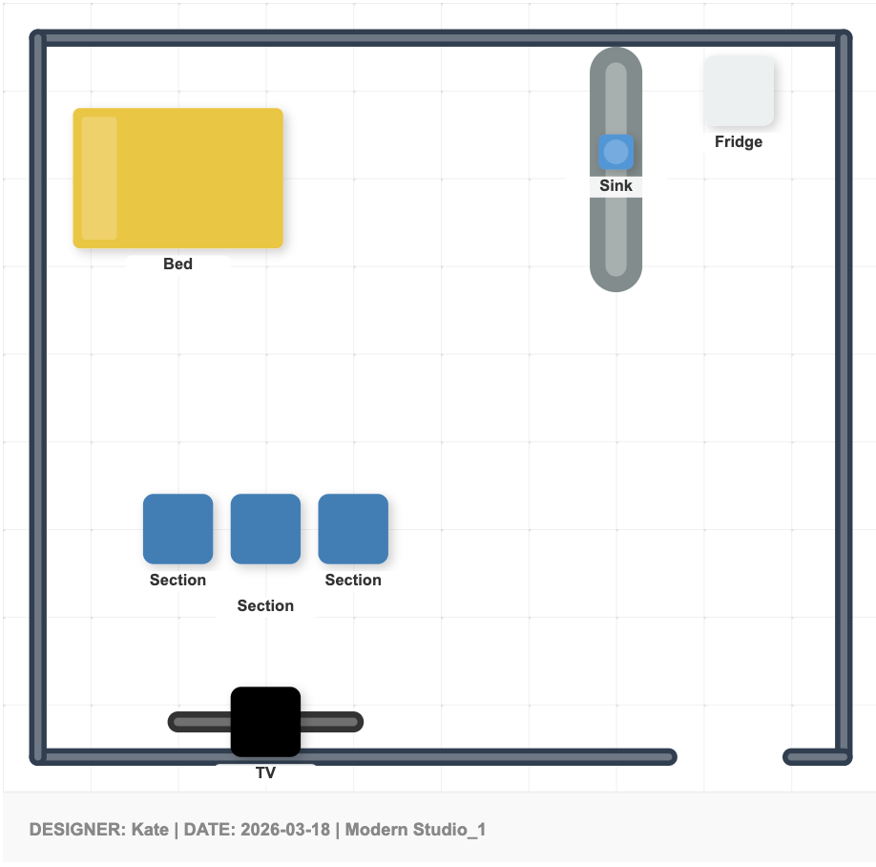
DESIGN INTELLIGENCE
Intention over Pixels.
Furniture in Swatch isn't just a symbol—it's a smart spatial element with built-in design logic.
Architectural details like soft shadows and high-contrast labels are automatically applied, ensuring professional results every time.

Slide 5





The Spatial Brain
Collision Logic
Boundary Safety
Type Safety
The compiler calculates bounding boxes to ensure furniture doesn't unintentionally overlap with walls.
Every element is validated to stay strictly within the Layout dimensions.
The analyzer ensures data consistency and structural validty across all design operations.

Slide 6
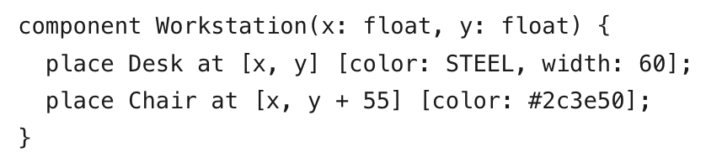
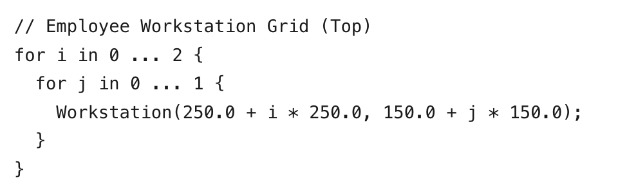
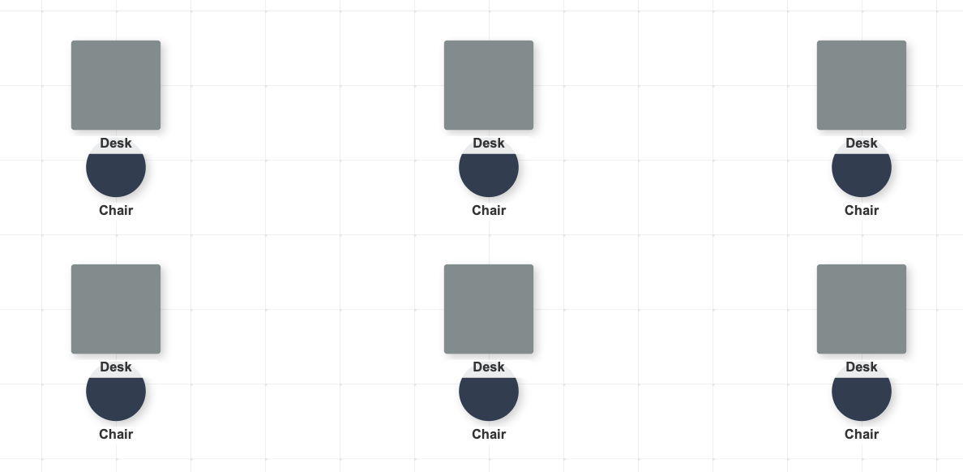
Scaling the Design
Generative Logic.
What about spaces with repititive elements like office desks?
Using loops and components, Swatch transforms repetitive architectural tasks into elegant algorithmic patterns.

Slide 7
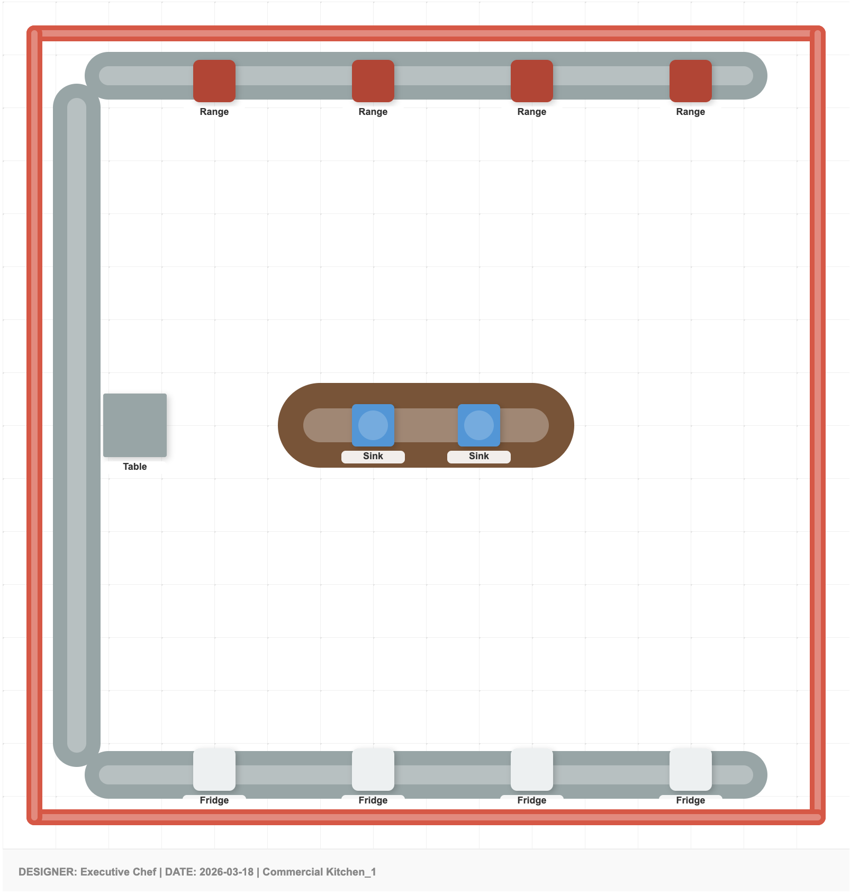
Lightweight Architecture
Pure SVG Export.
Compiles directly to high-quality, scalable SVG. No bloated files—just clean, vector-perfect geometry ready for the web or the printer.

Slide 8
Thank you for listening
Questions?
https://k-galvin.github.io/swatch/

